Slide 1
Lab Meeting
Maddie Gastonguay
12/14/2022

Slide 2
A Bit About My Background

Slide 3
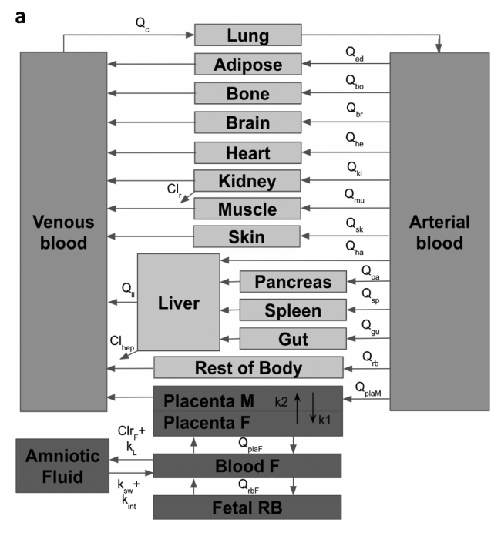
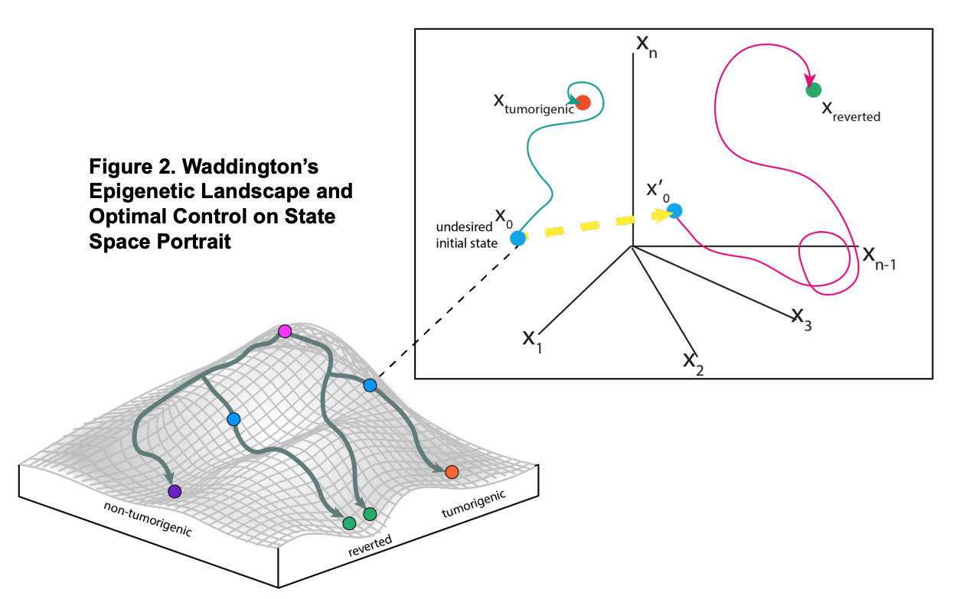
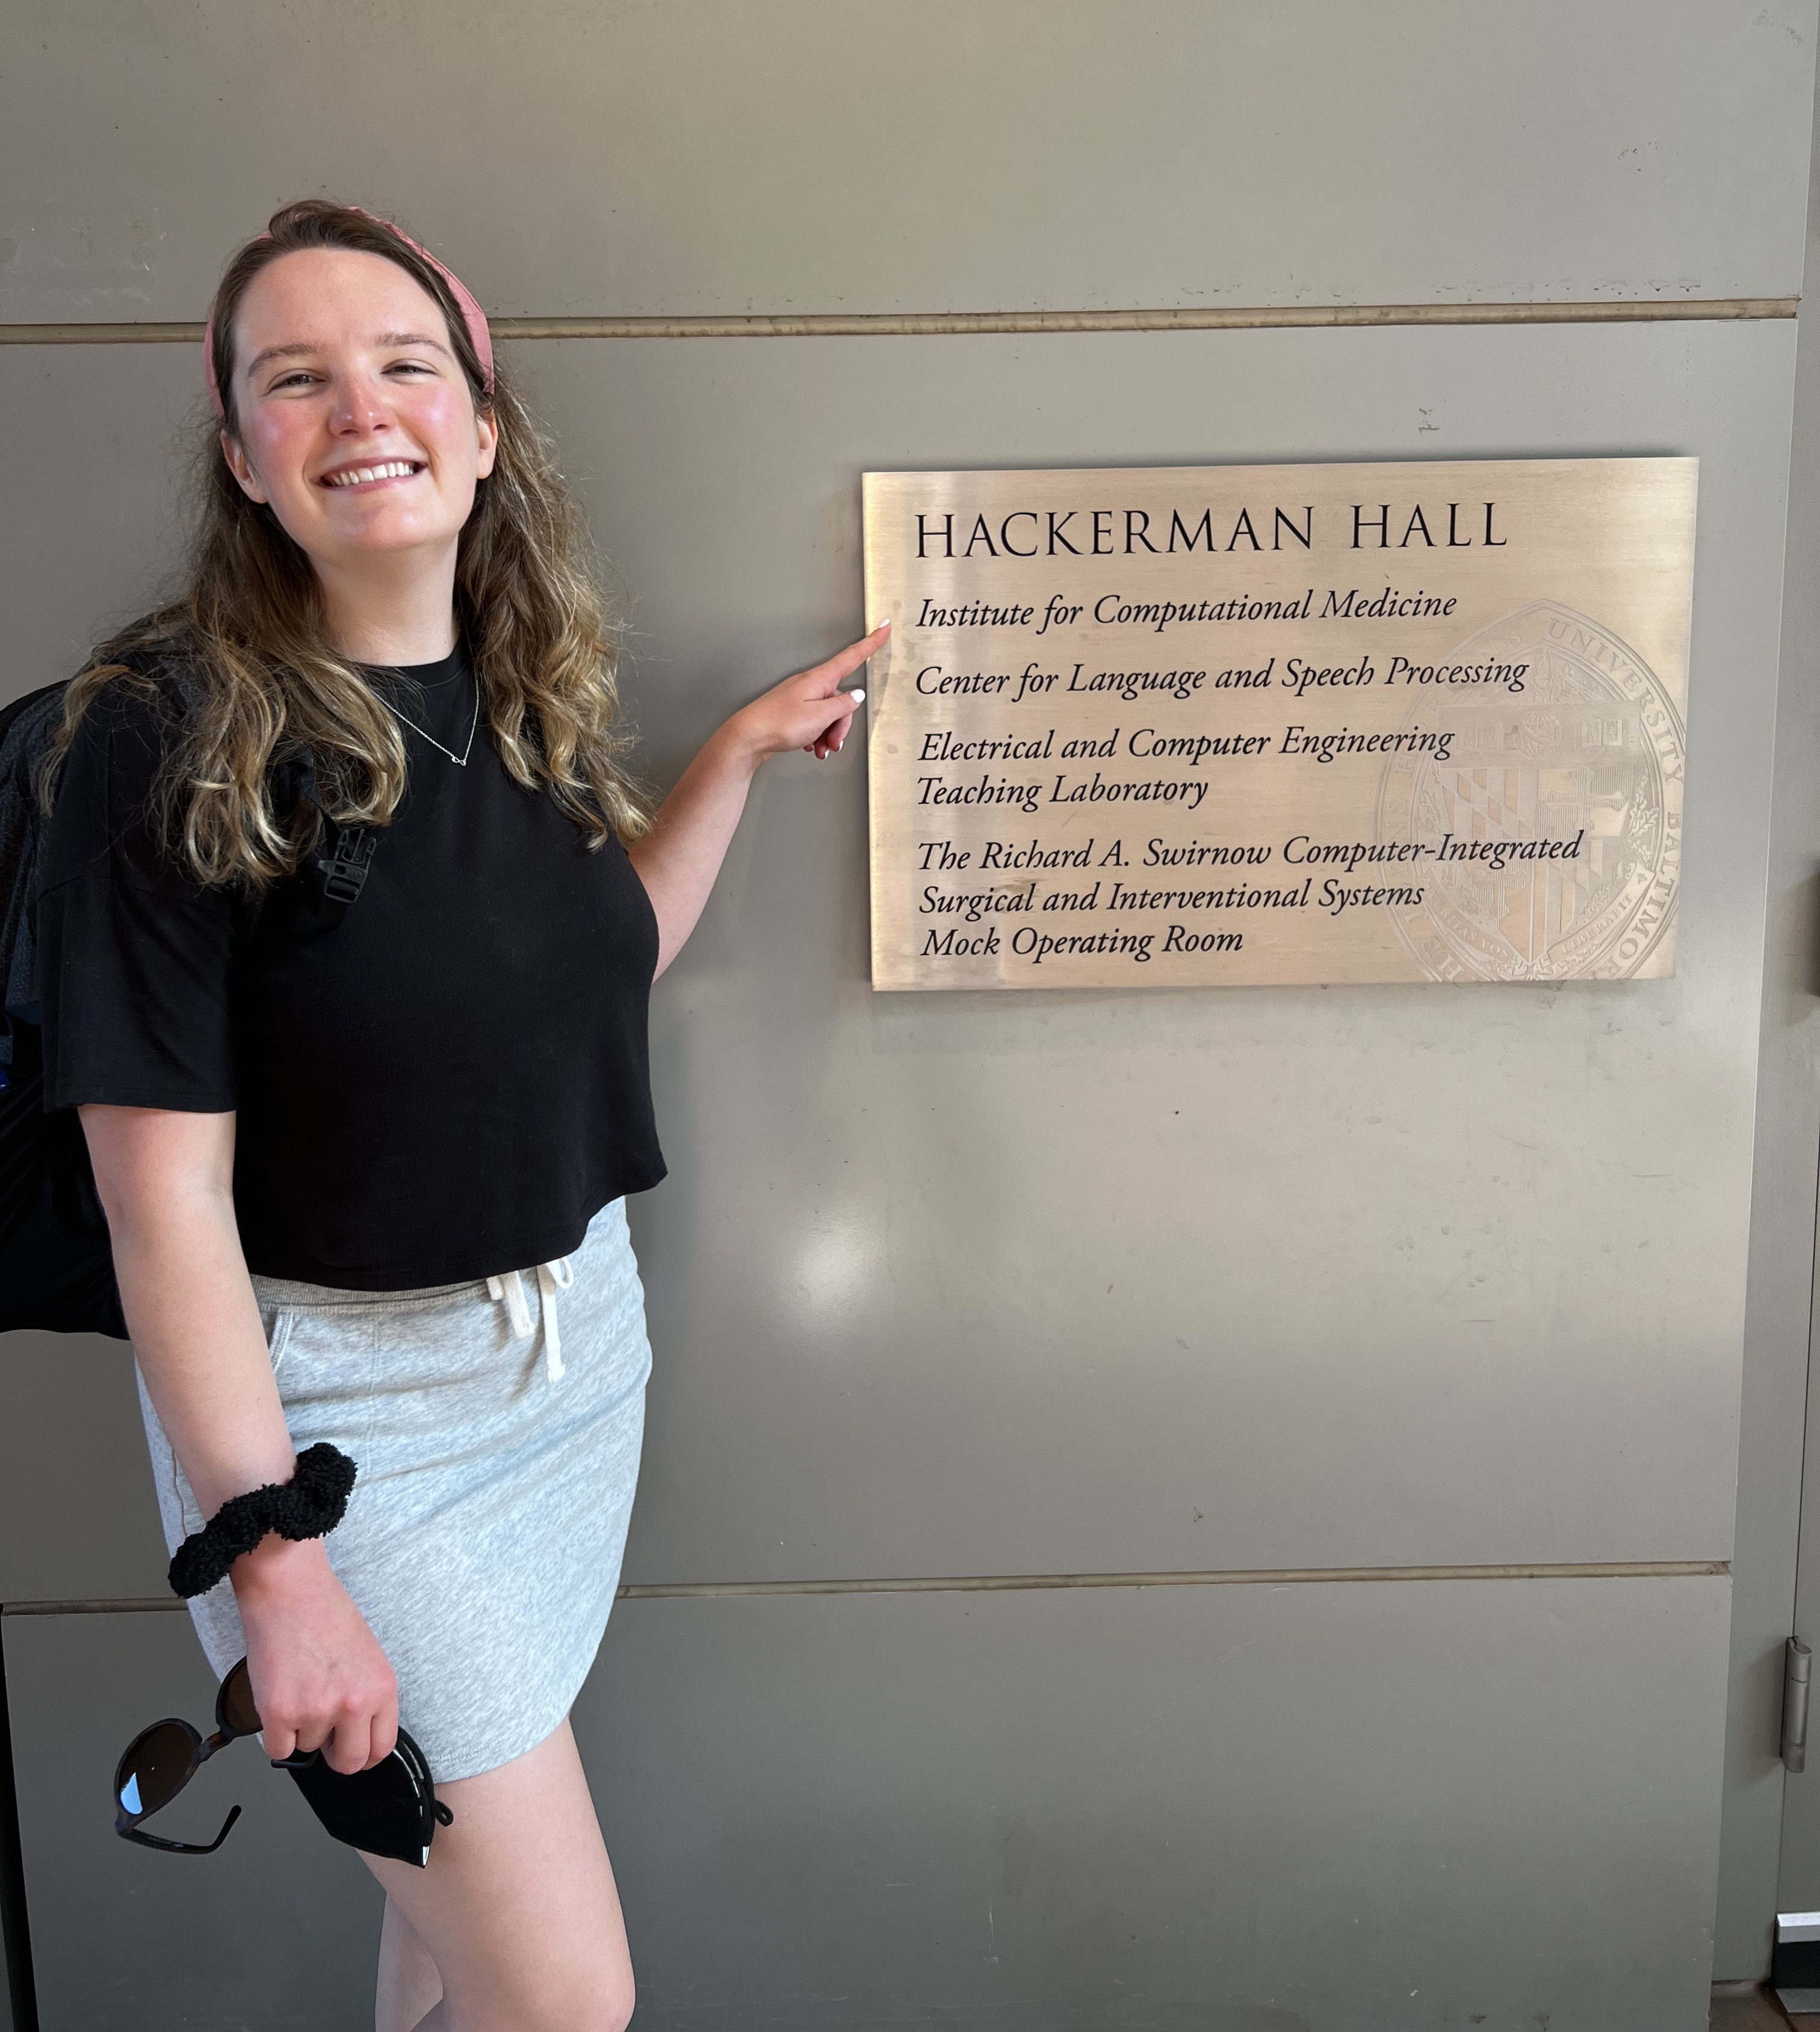
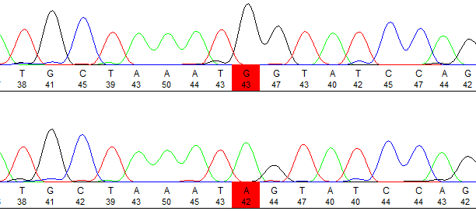
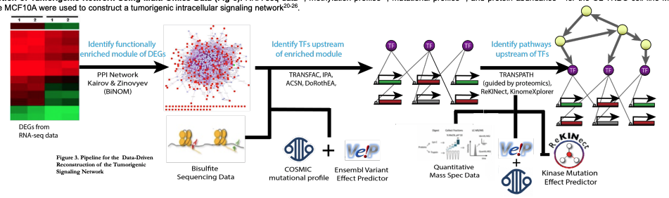
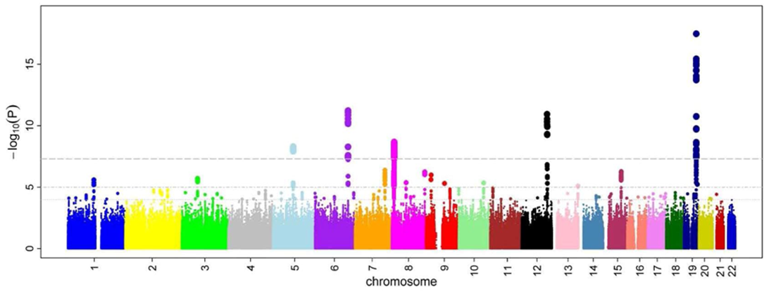
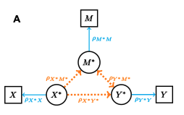
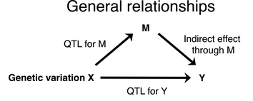

Slide 4
A QSP Model for VEGF Signaling in Prostate Cancer Metastasis

Slide 5
Background
Vascular endothelial growth factor (VEGF) signaling plays an important role in cancer angiogenesis
Anti-VEGF therapies have success for some cancers but not all
Overall survival in prostate cancer is not improved by anti-VEGF therapeutics
Semaphorin (Sema) family members compete with VEGFs for Neuropilin binding and can have pro- or anti-angiogenic activity themselves

Slide 6
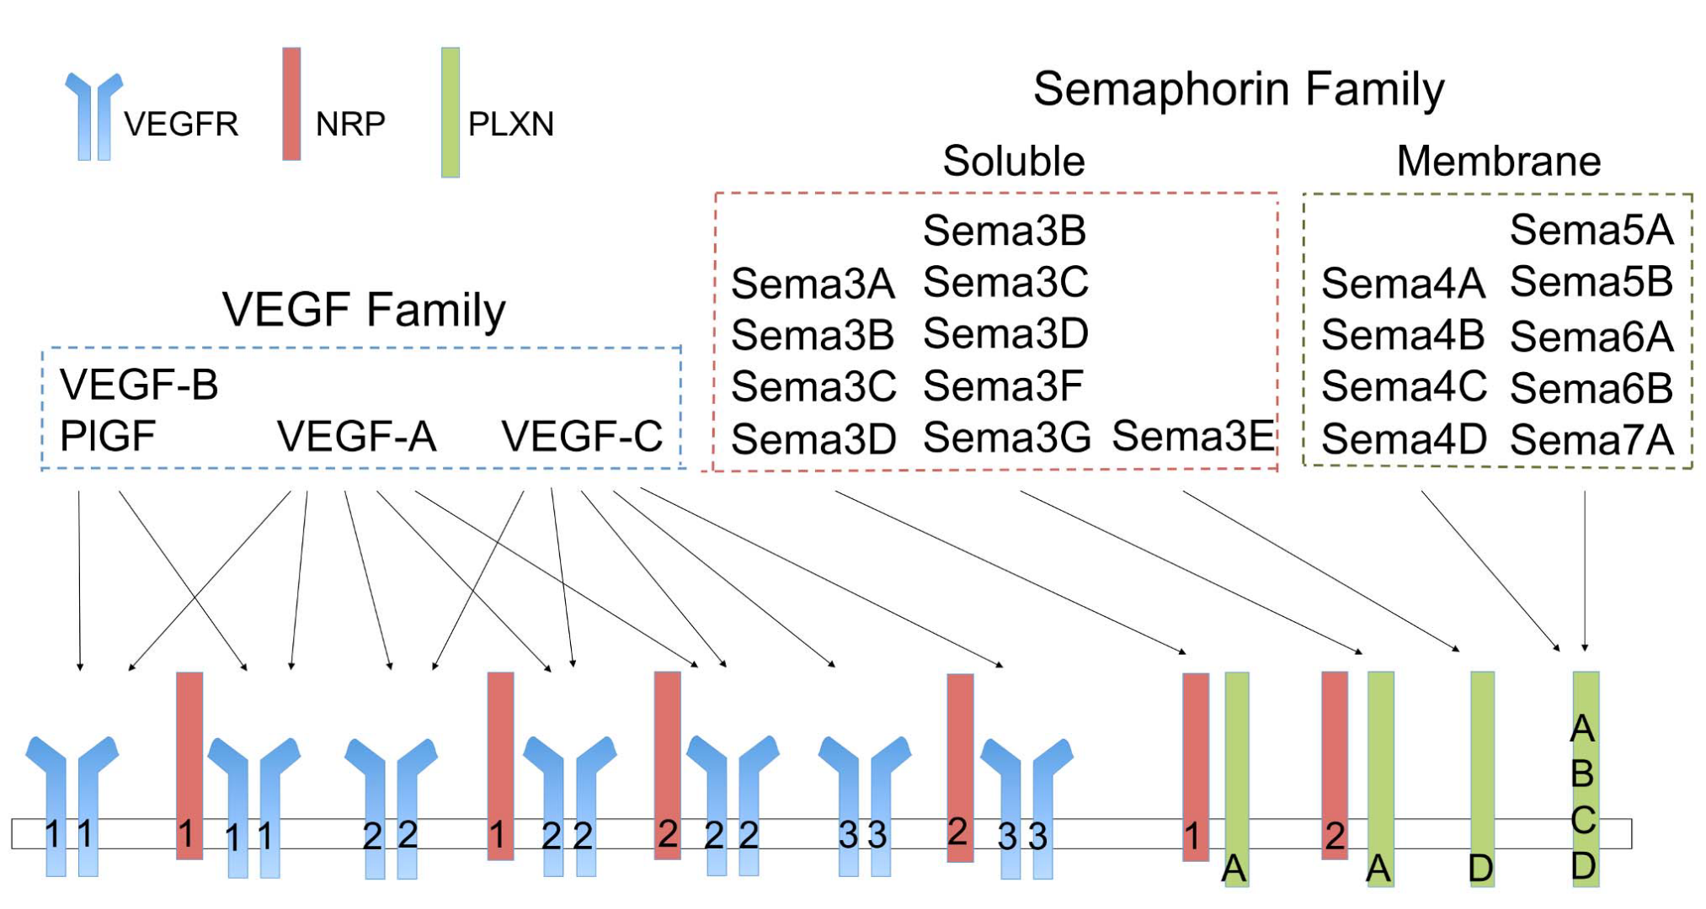
Ligand-Receptor Interactions for the VEGF and Semaphorin Families
“Break”
“Accelerator”
Bender and Mac Gabhann, PLOS ONE, 2013

Slide 7
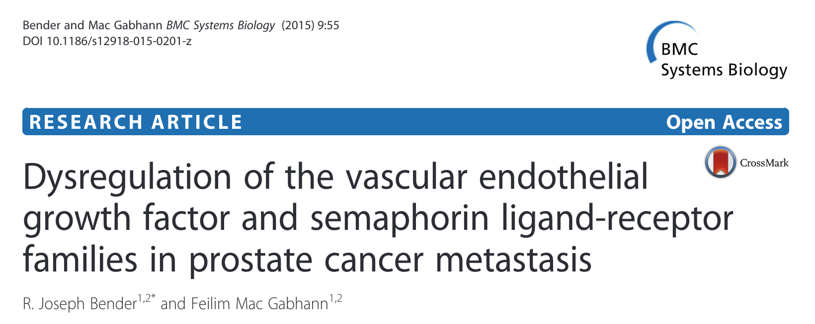
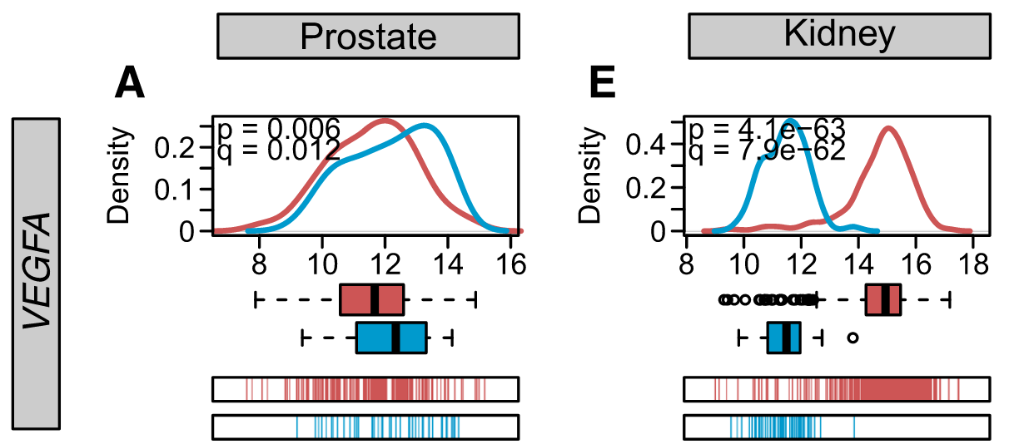
Primary Prostate Tumors do not Exhibit Increased VEGF

Slide 8
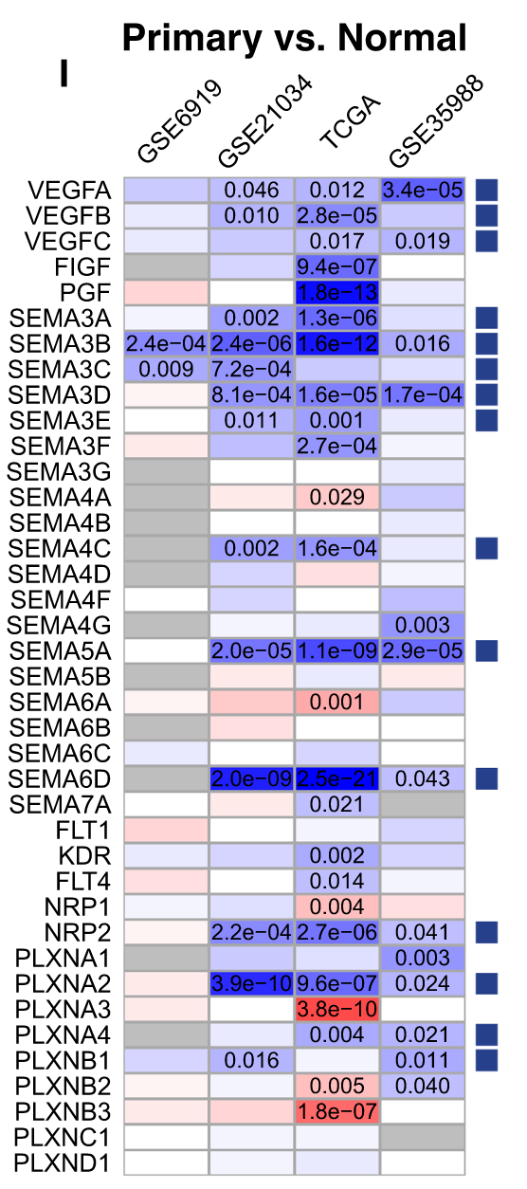
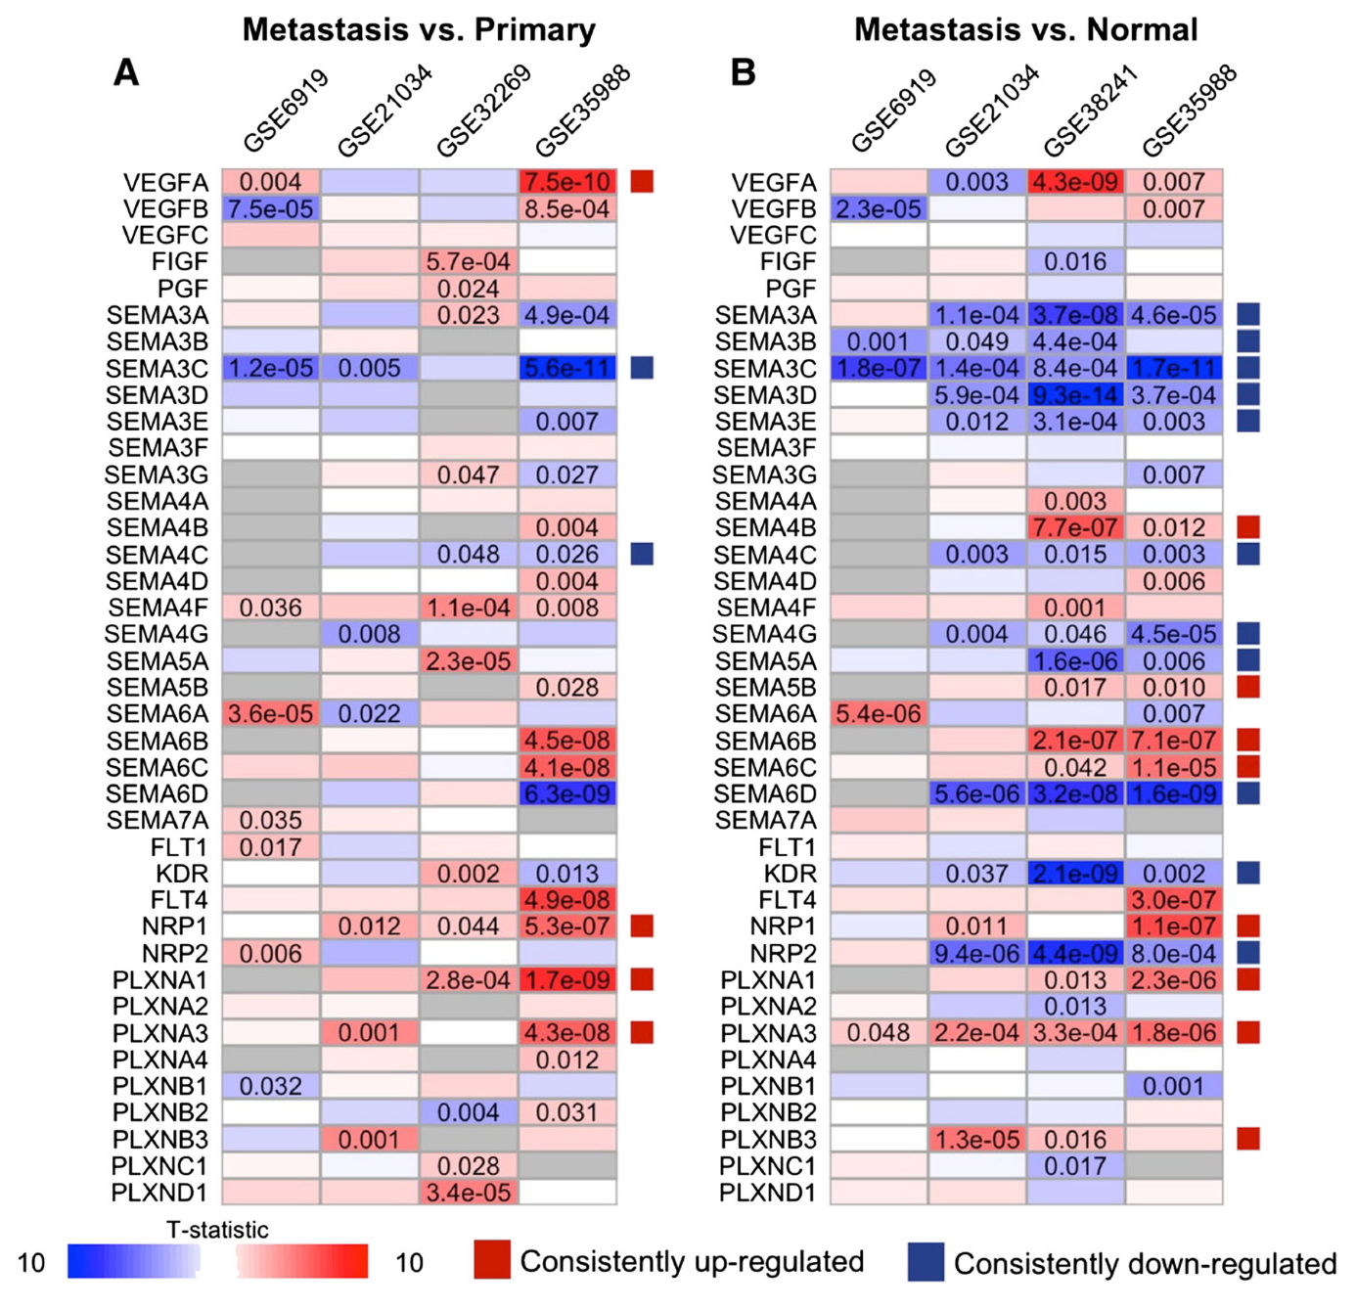

Slide 10
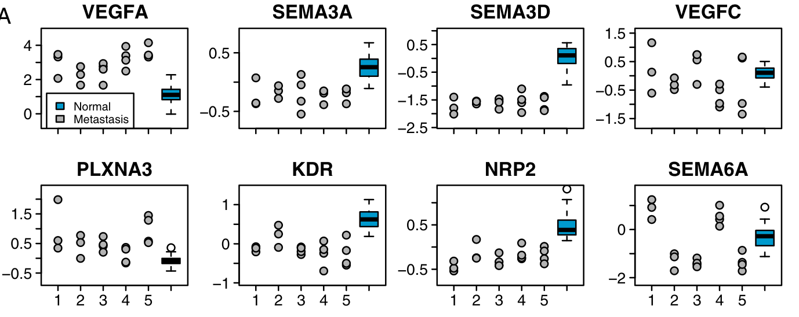
Consistency Between Metastases from the Same Patient

Slide 11
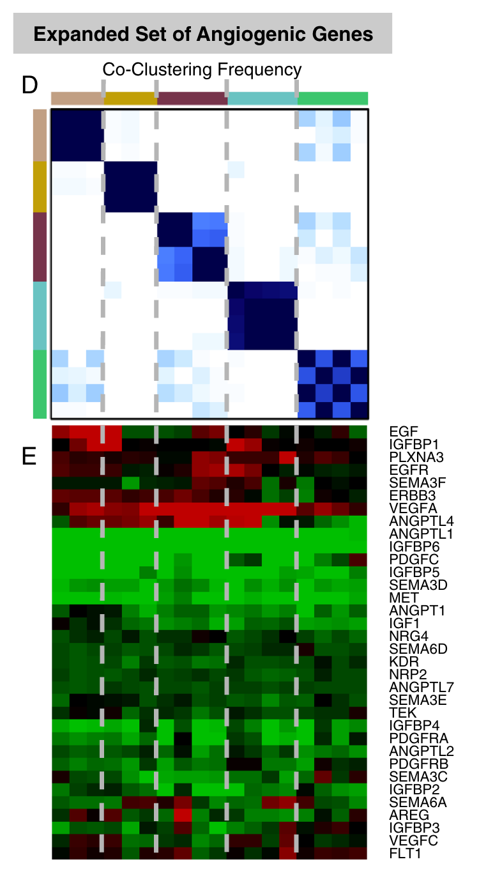
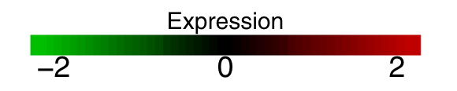
Consistency Between Metastases from the Same Patient

Slide 12
How would a patient respond to treatment when the primary and metastatic tumors have different VEGF signaling?
Question:

Slide 13
Goals
Build a model for VEGF Signaling in prostate cancer
Simulate stochastic appearance of metastases
Alter secretion rates in each compartment according to gene expression data
Simulate therapeutic intervention

Slide 14
Model in Joe’s Paper
Ligand
Secretion
Ligands | Receptors
VEGFA₁₆₅ VEGFA₁₂₁ VEGFB₁₆₇ VEGFB₁₈₆ VEGFC VEGFD PlGF1/2 Sema3A-G | VEGFR1/2/3 NRP1/2 Plexins sVEGFR1
ECM
Tumor Cells
Endothelial Cells
Binding
Binding
PBM
EBM

Slide 15
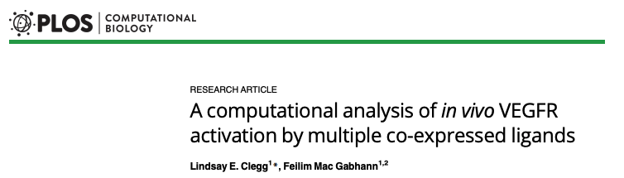
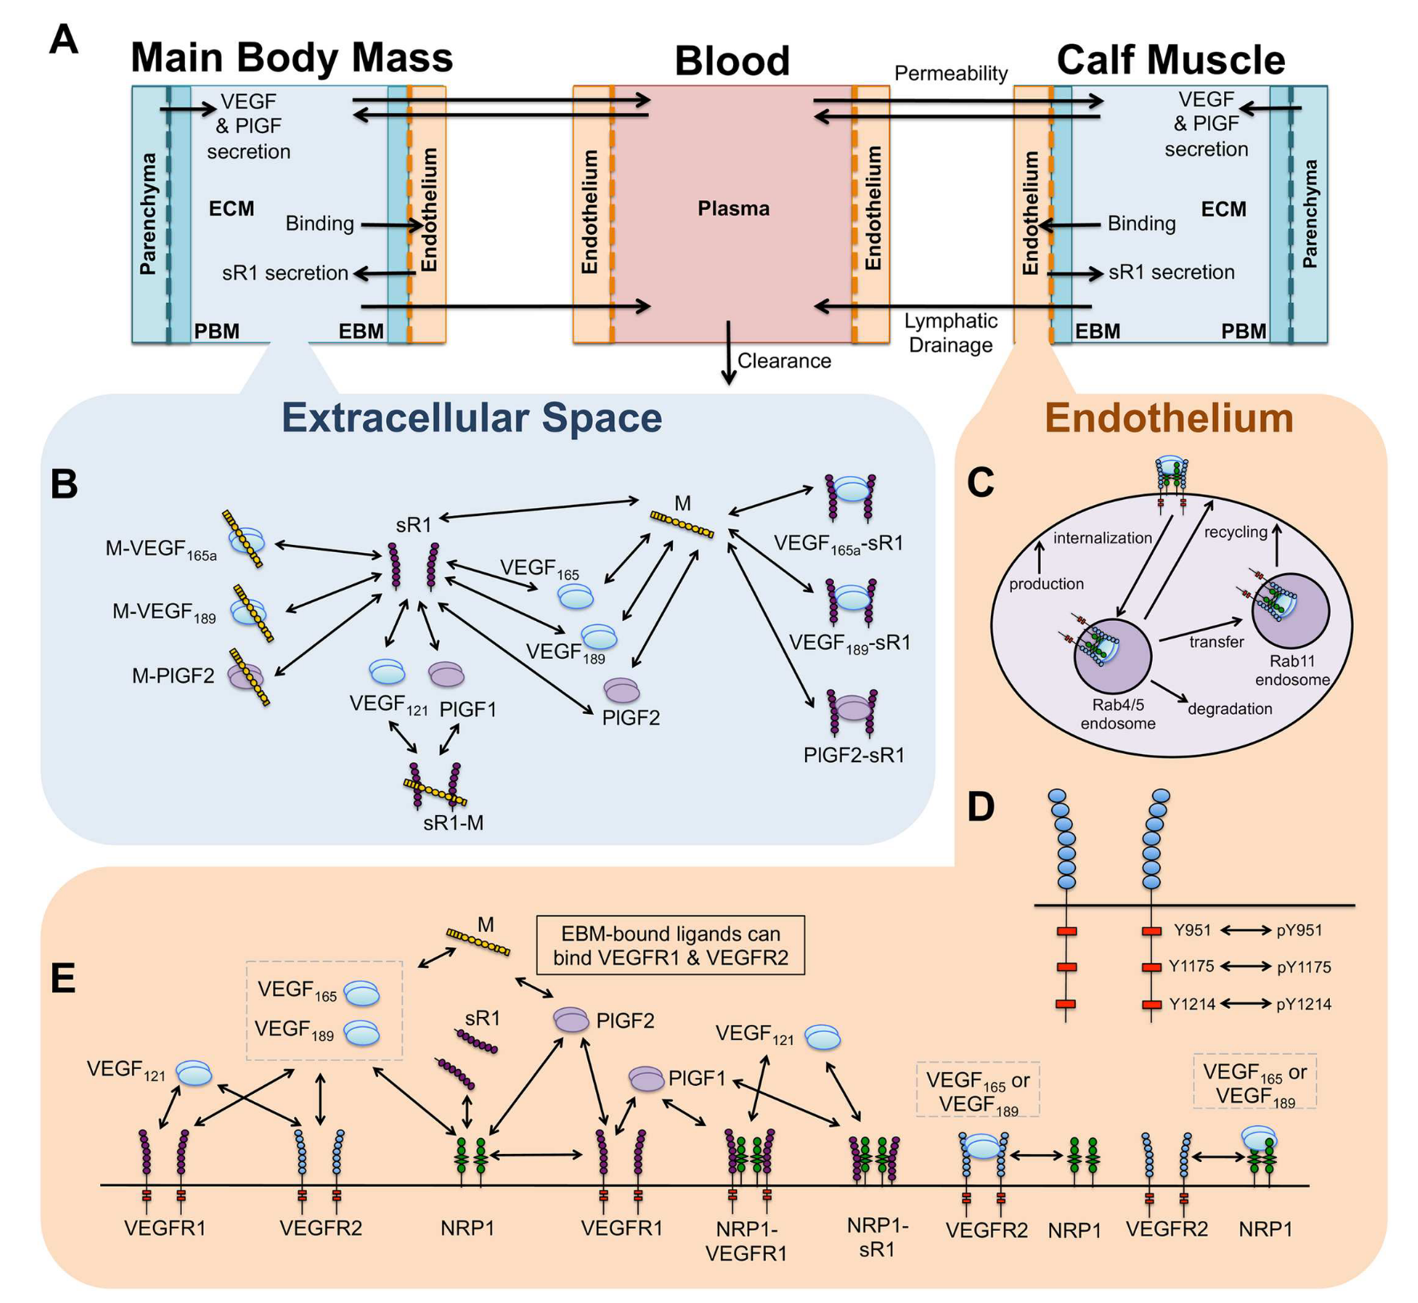
Model in Lindsay’s Paper

Slide 16
My Simplifications

Slide 17
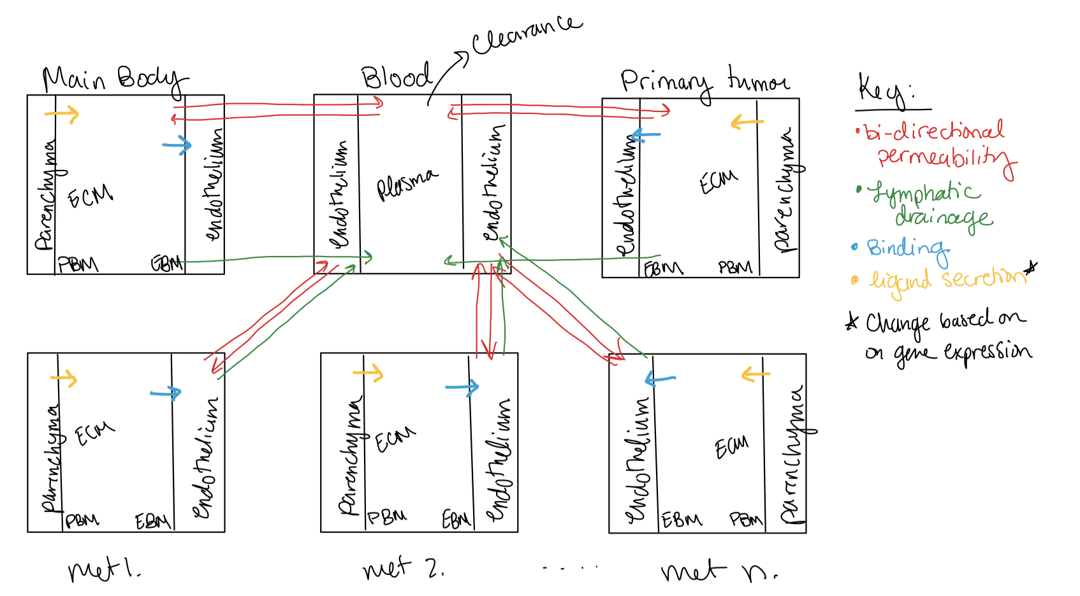
My Proposed Model

Slide 18
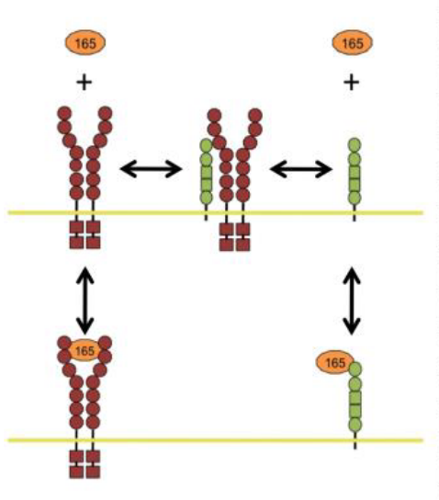
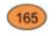
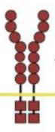
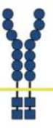
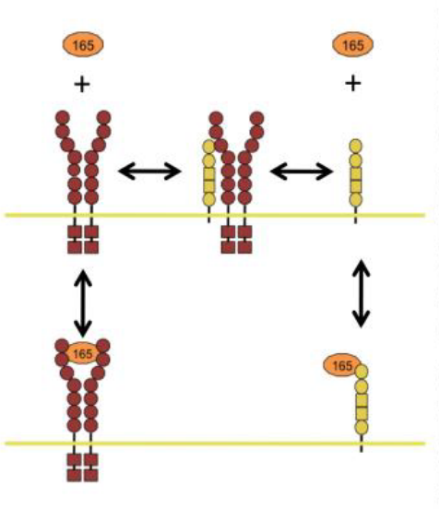
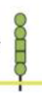
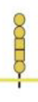

17 Reactions
VEGFR1 Binding:
Key:
VEGF₁₆₅
VEGFR1
VEGFR2
NRP1
NRP2
Matrix

Slide 19
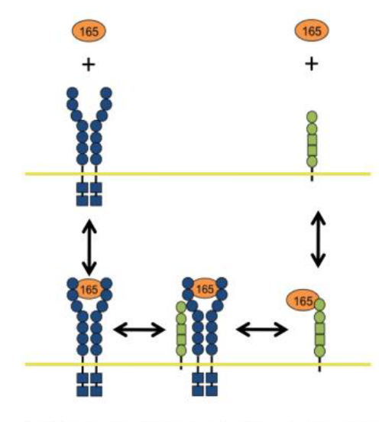
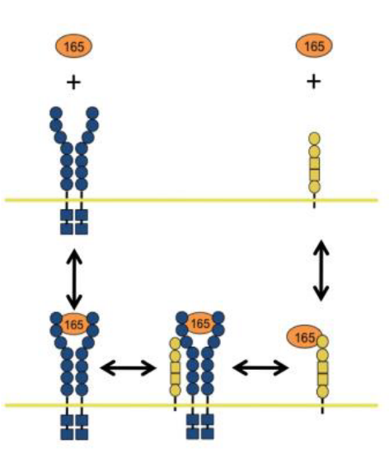
17 Reactions
VEGFR1 Binding:
VEGFR2 Binding:
Key:
VEGF₁₆₅
VEGFR1
VEGFR2
NRP1
NRP2
Matrix

Slide 20
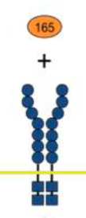
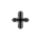
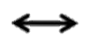
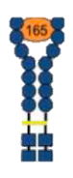
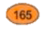
17 Reactions
VEGFR1 Binding:
VEGFR2 Binding:
Matrix Binding:
Key:
VEGF₁₆₅
EBM
VEGFR1
Also occurs with VEGFR1
VEGFR2
EBM
EBM
NRP1
PBM
PBM
NRP2
ECM
ECM
Matrix

Slide 21
17 Reactions
VEGFR1 Binding:
VEGFR2 Binding:
Matrix Binding:
Key:
VEGF₁₆₅
EBM
VEGFR1
21 ODEs
60 Parameters
Implemented in Matlab
Also occurs with VEGFR1
VEGFR2
EBM
EBM
NRP1
PBM
PBM
NRP2
ECM
ECM
Matrix

Slide 22
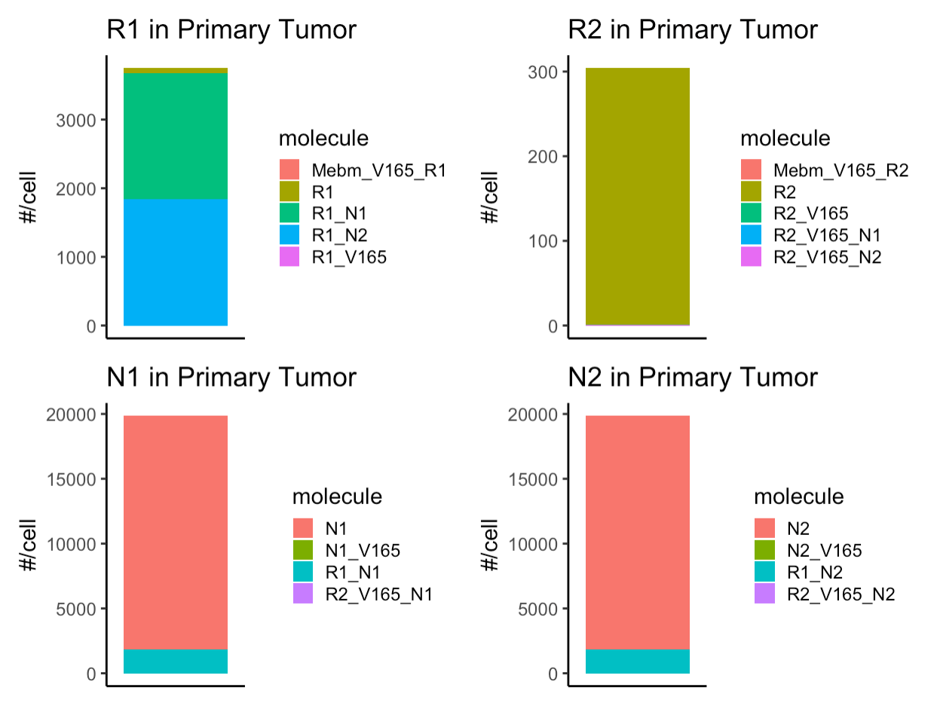
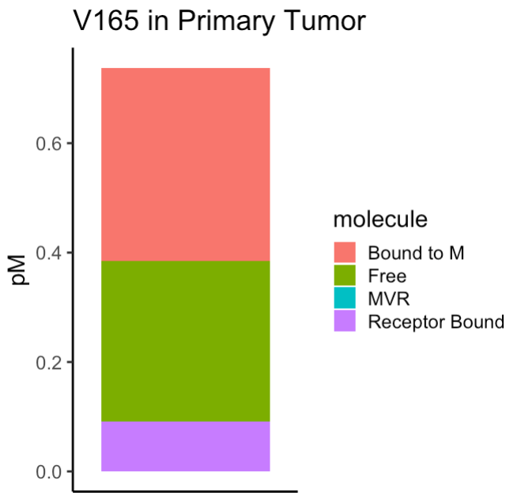
First Round of Simulations: No Metastasis

Slide 23
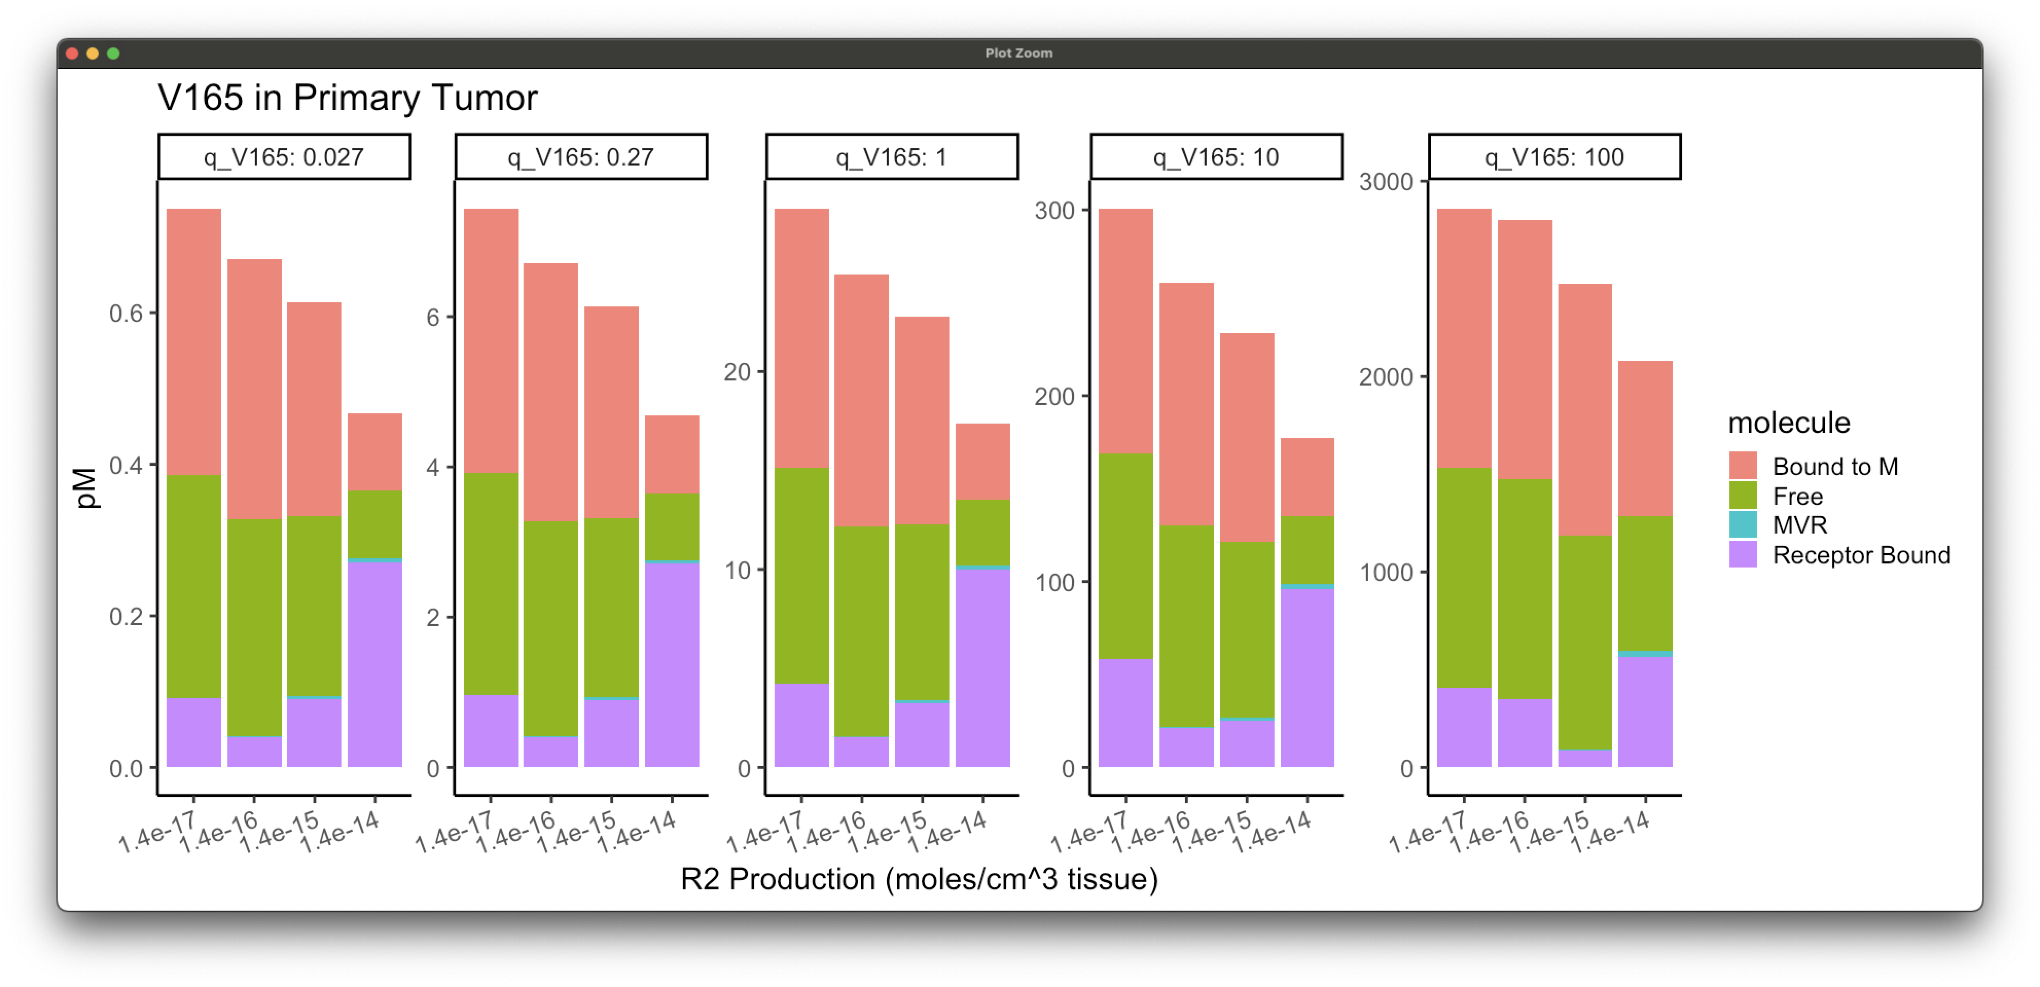
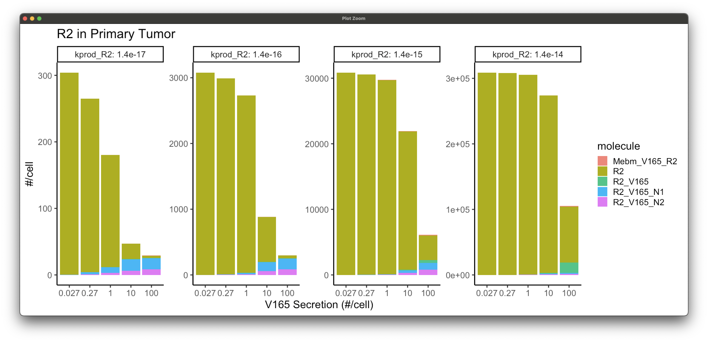
Increased Ligand Secretion and R2 Production

Slide 24
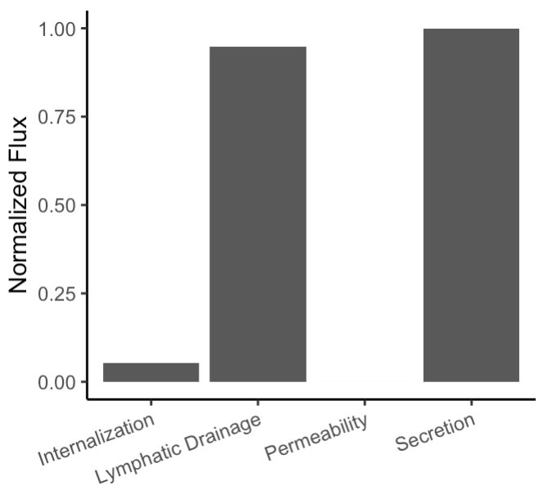
Fluxes
Primary Tumor
Blood
Lymphatic Drainage
PBM
EBM
ECM
Parenchyma
Endothelium
Internalization
Permeability
Secretion

Slide 25
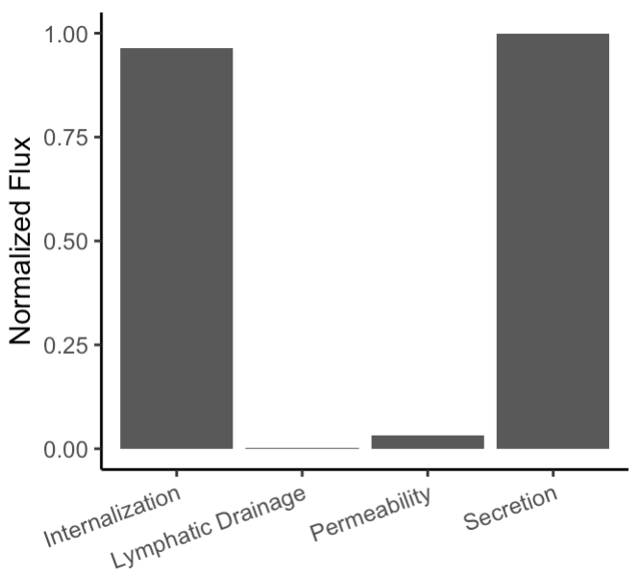
Fluxes With Updated Lymphatic Drainage
Primary Tumor
Blood
Lymphatic Drainage
PBM
EBM
ECM
Parenchyma
Endothelium
Internalization
Permeability
Secretion

Slide 26
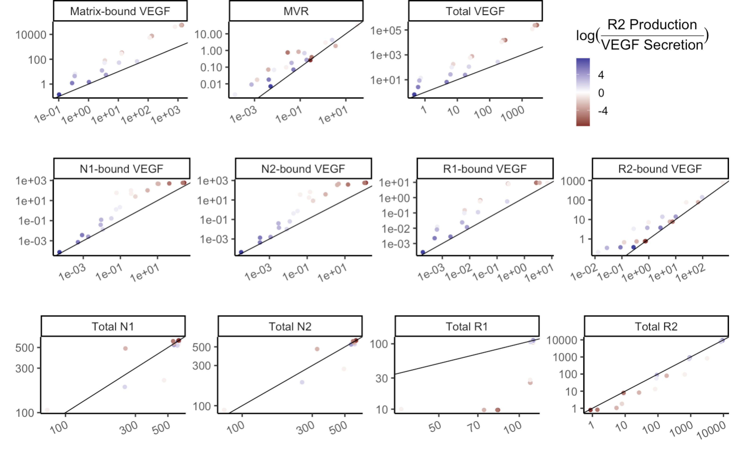
Simulations with New Lymphatic Drainage
Concentration with Updated Parameters (pM)
Concentration with Original Parameters (pM)

Slide 27
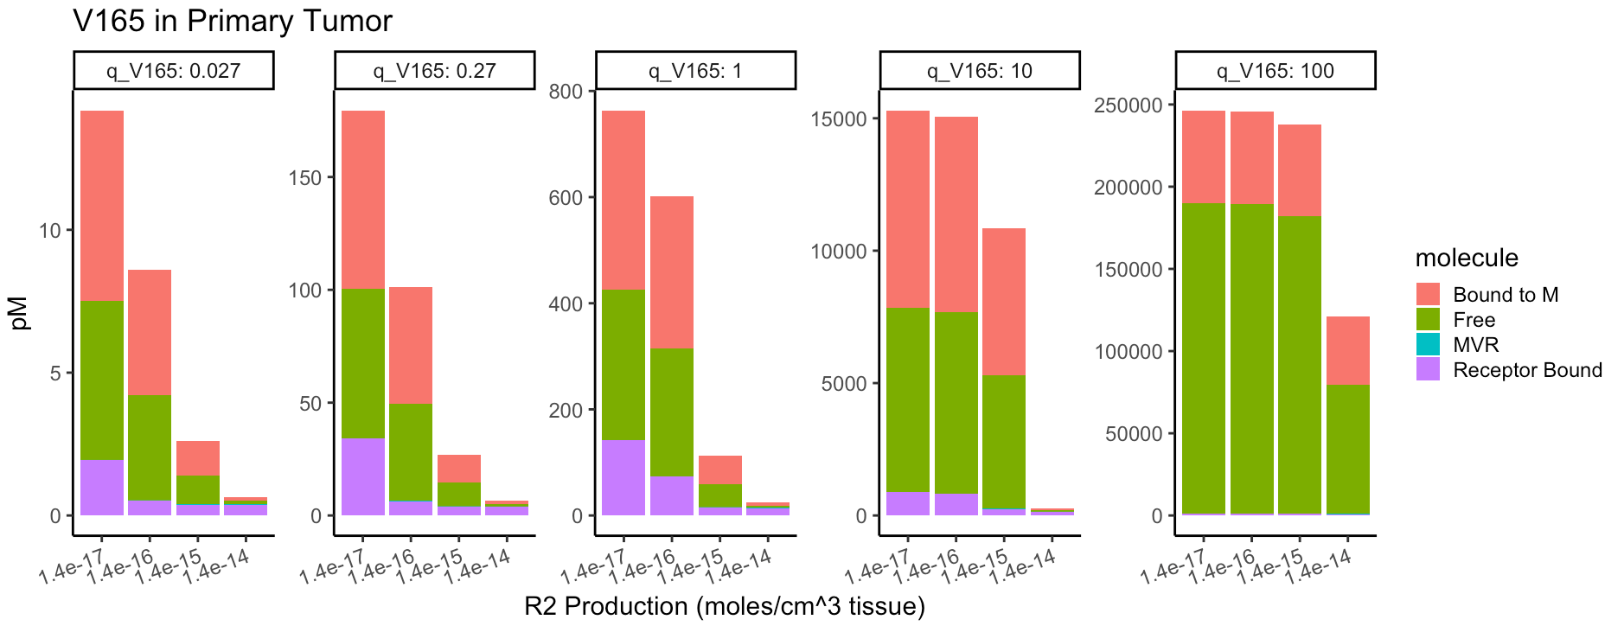
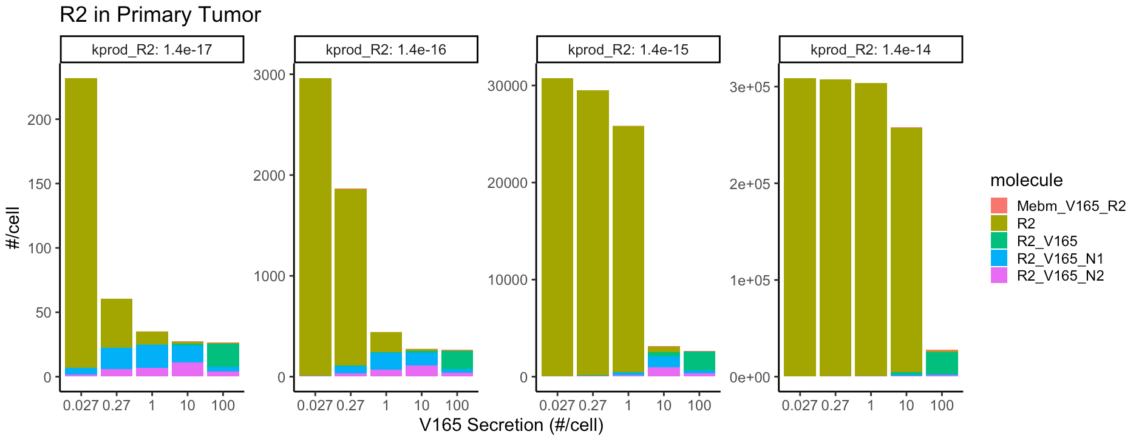
Simulations with New Lymphatic Drainage

Slide 28
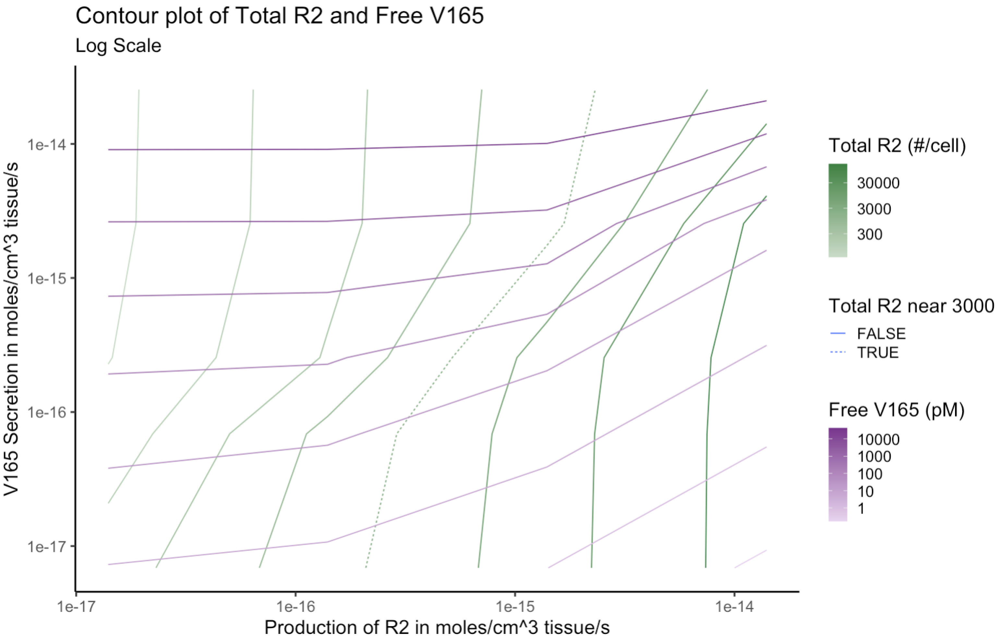
Sensitivity to VEGF Secretion and R2 Production

Slide 29
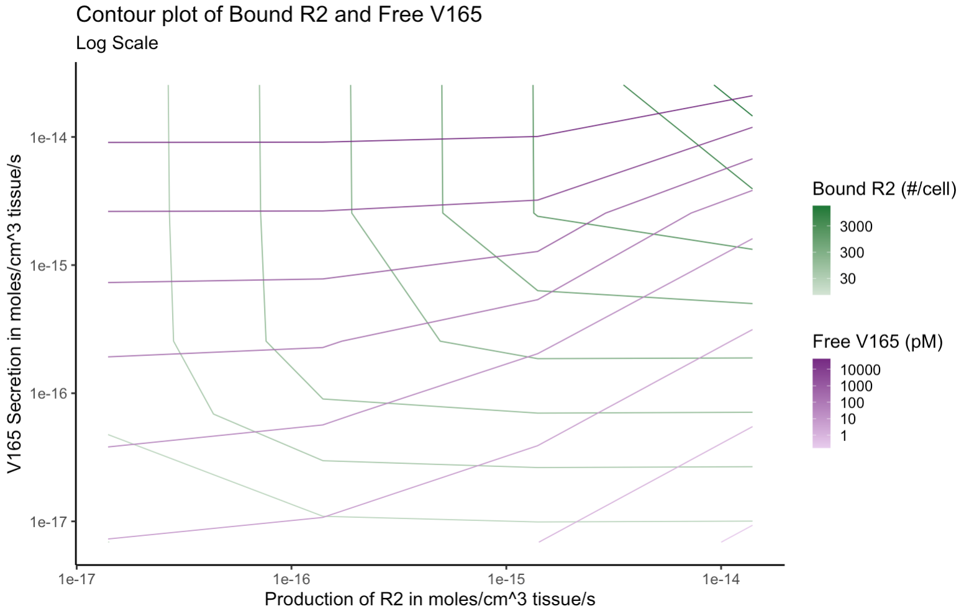
Sensitivity to VEGF Secretion and R2 Production

Slide 30
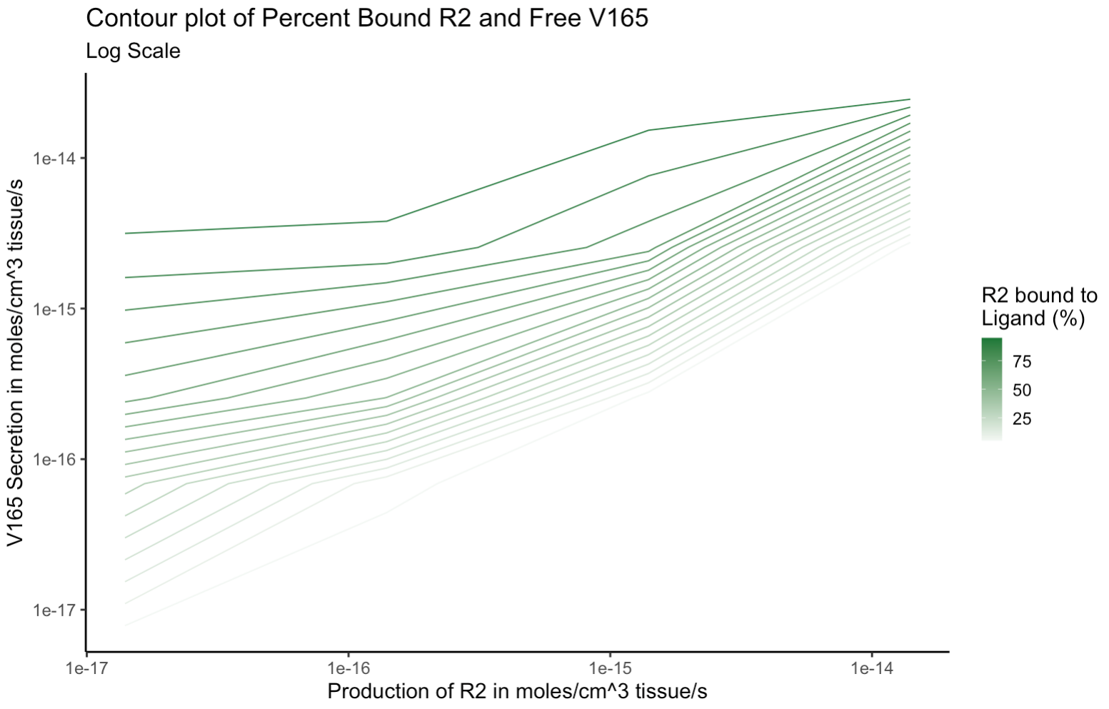
Sensitivity to VEGF Secretion and R2 Production

Slide 31
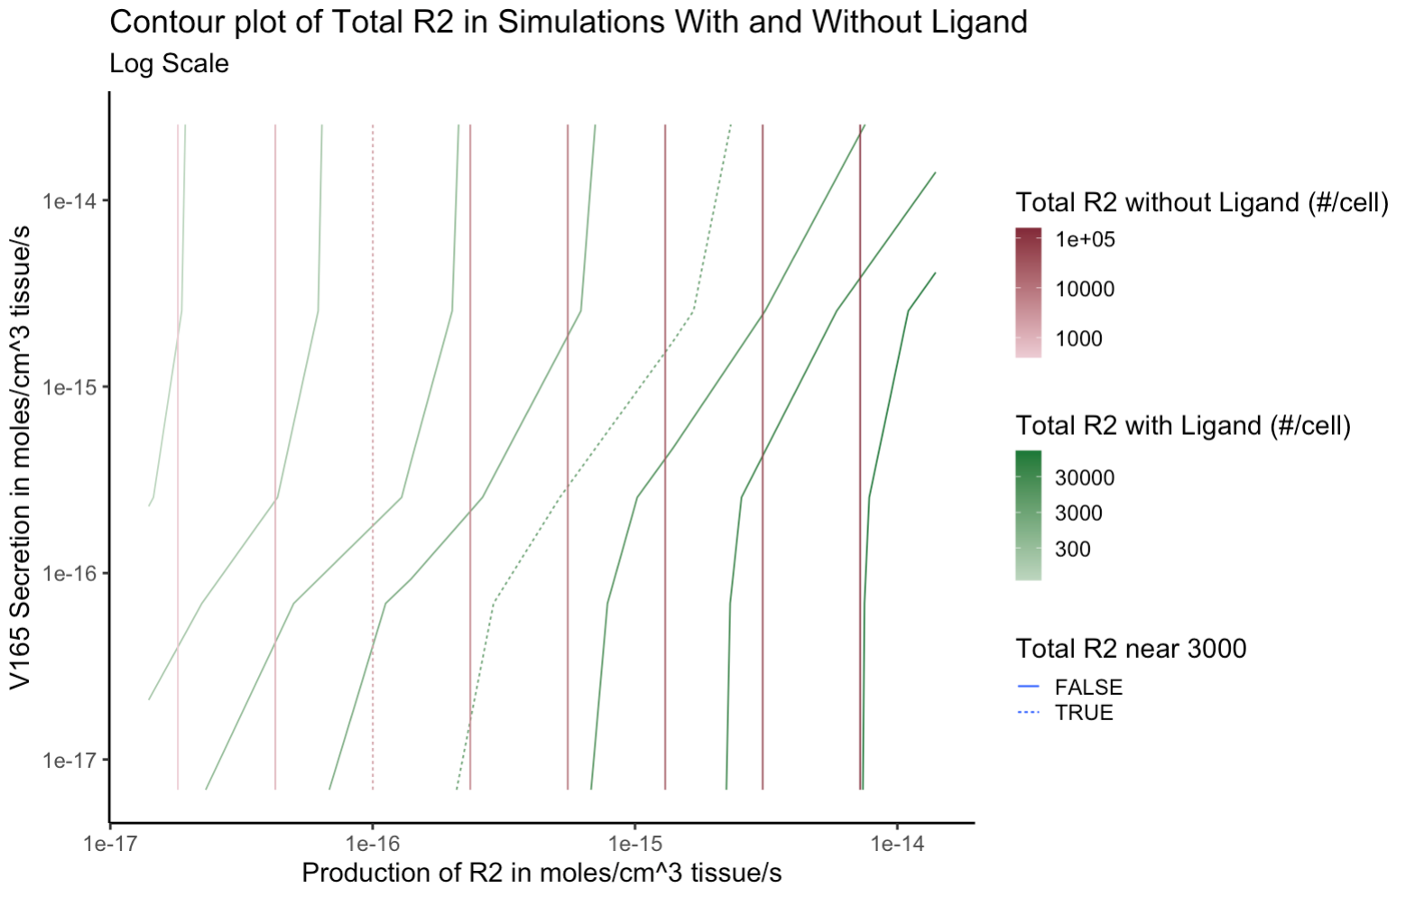
Sensitivity to VEGF Secretion and R2 Production

Slide 32
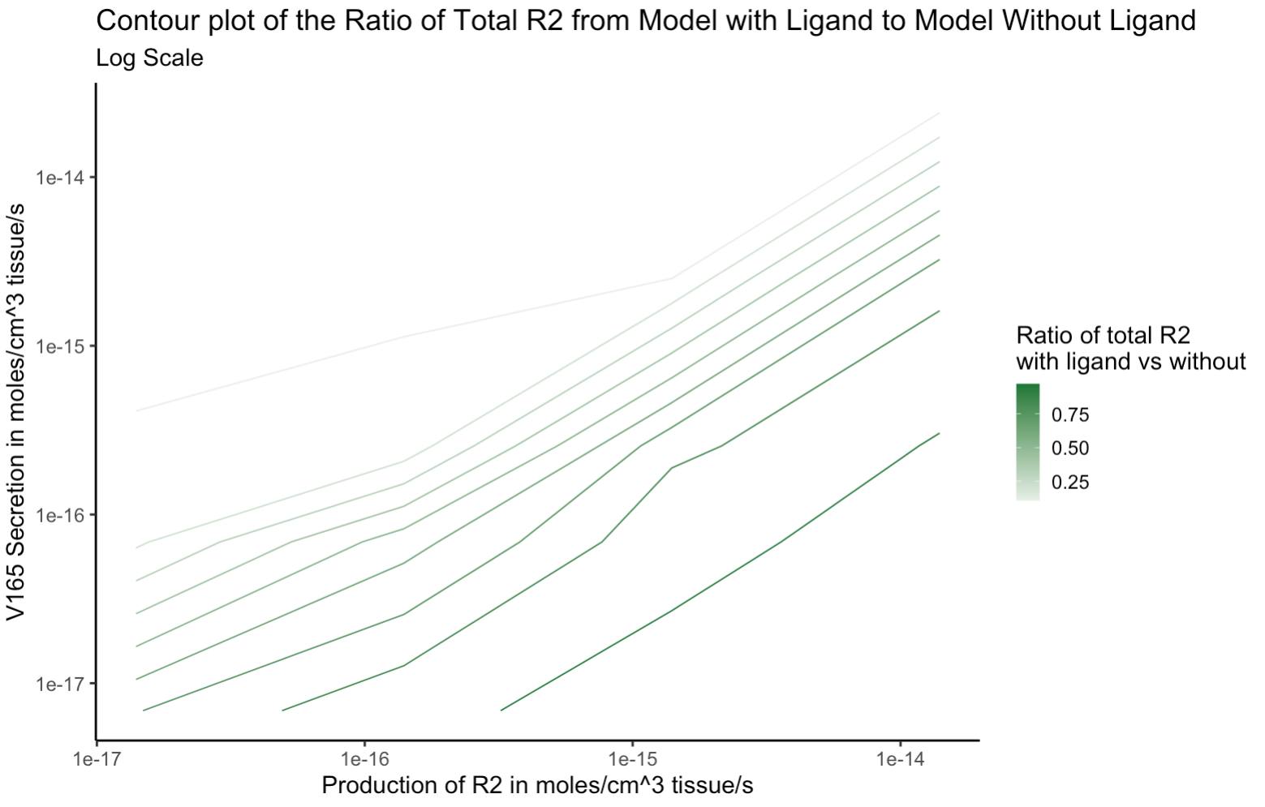
Sensitivity to VEGF Secretion and R2 Production

Slide 33
Future Directions
Implement stochastic appearance of metastasis compartments
Parameterize the cancer compartments by altering secretion levels from nominal value using gene expression data for primary and metastatic tumors
Simulate therapeutic intervention
Include more ligands and receptors
Add receptors to tumor cells

Slide 34
Physiologically Based Pharmacokinetic (PBPK) vs Compartmental PK Models

Slide 35
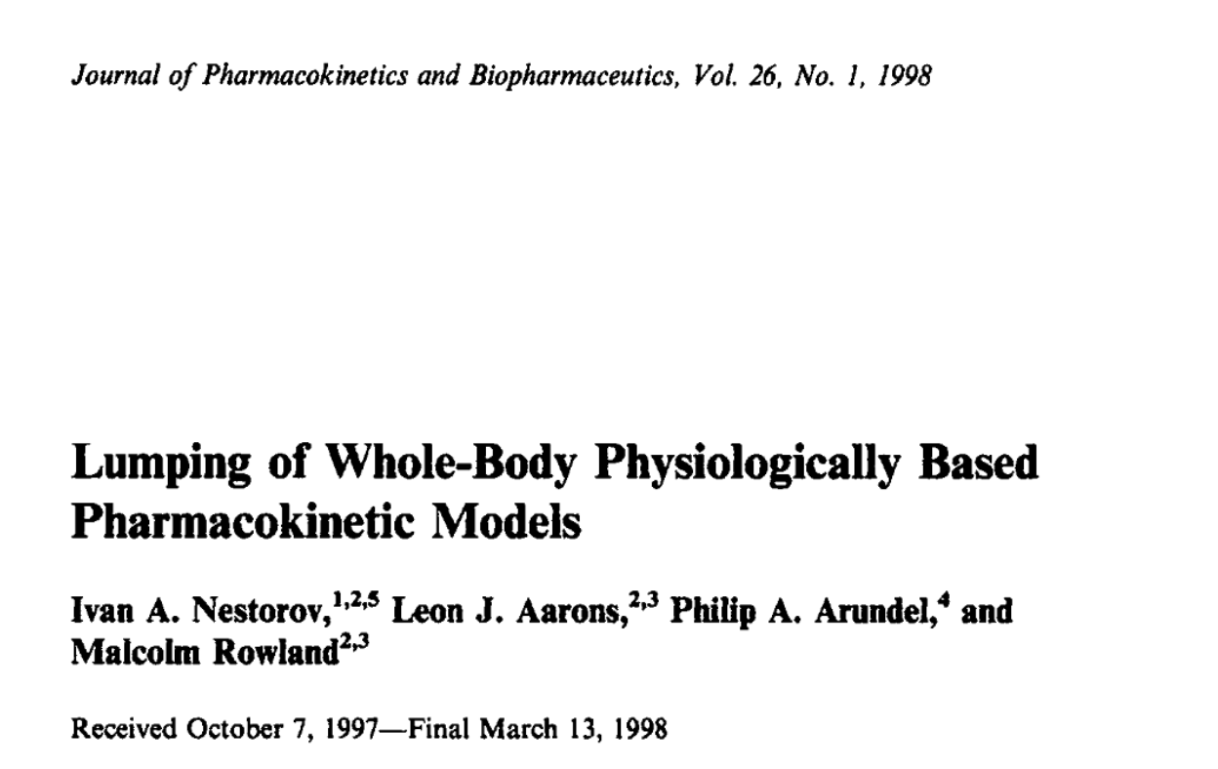
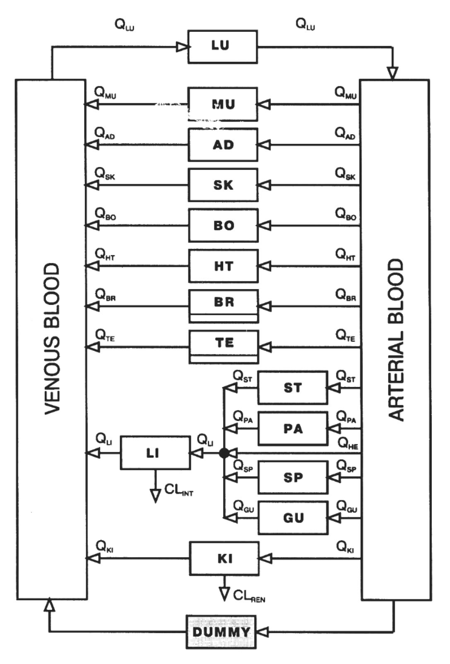
Rules for lumping parallel and serial tissues so that minimal information is lost:
Parallel tissues should be lumped only if they have similar time constants
What is “similar”?
Serial tissues should be lumped only if they have small time constants (ie. Equilibrate rapidly with each other)
Derived equations for lumped model parameters from full PBPK model parameters

Slide 36
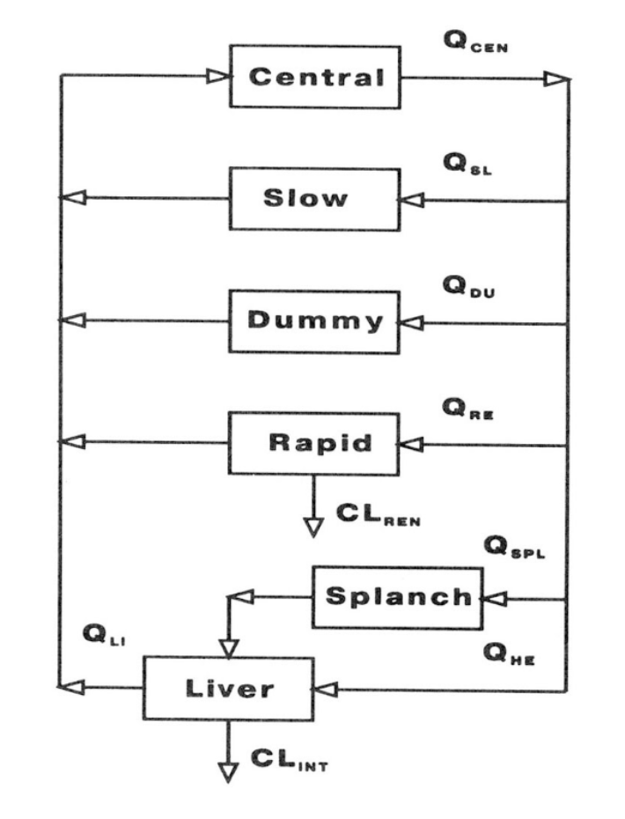

Slide 37


Slide 38



Central
k₁₂
Peripheral
k₂₁
k_{E}

Slide 39


Slide 40

Two-Compartment
Lumped Physiological
Central
k₁₂
Peripheral
k₂₁
k_{E}

Slide 41

Classical models underestimate the volume of distribution, which leads to over-predicting peripheral tissue concentration:
Lumped Physiological
Two-Compartment
Central
k₁₂
Peripheral
k₂₁
k_{E}

Slide 42

Simulated oral administration of 20 drugs using:
Full PBPK Model
Lumped PBPK Model
Compartmental PK Model (1 or 2 compartments)
Assessed the compatibility of all three models by comparing:
AUC for the concentration-time curve
Volume of distribution (V_{d})
Clearance (CL)

Slide 43

Model | Central | Peripheral
Full PBPK | Lungs, arterial blood, venous blood | Adipose, bone, brain, muscle, skin, heart, rest of body
Lumped Model | Lumped central compartment (LCEN) | Non-eliminating tissues compartment (NET)

Slide 44
Model | Central | Peripheral
Full PBPK | Lungs, arterial blood, venous blood | Adipose, bone, brain, muscle, skin, heart, rest of body
Lumped Model | Lumped central compartment (LCEN) | Non-eliminating tissues compartment (NET)
Number of non-significantly different parameters between models:
Model | PBPK Model | Compartmental Model
Lumped Model | Central AUC: 18/20 Peripheral AUC: 19/20 V_{c}: 20/20 V_{p}: 19/20 CL: 20/20 | Central AUC: 14/20 Peripheral AUC: 3/9 V_{c}: 8/20 V_{p}: 1/9* CL: 19/20
* V_{p} is greater in the compartmental model than lumped model for all cases

Slide 45



Notes:
the apparent ideal volume of distribution was close to that of the unbound drug fraction.

Slide 46

Drug concentration of each tissue in the PBPK model could be indirectly estimated by using the drug concentration of the lumped and compartment models when the three models were compatible for drug concentration (AUCs):

Slide 47
Summary
Lumped and compartmental models can recapitulate concentration profiles in central tissues
Lumped models can recapitulate concentration profiles in peripheral tissues while compartmental models frequently cannot
It is unclear if peripheral compartment concentrations and V_{d} are over- or under- estimated
When the three models are compatible in concentration, the tissue concentrations from a full PBPK model can be recovered from the lumped and compartmental model

Slide 48
Musings for Future Projects

Slide 49

At a cellular level, tumor cells maintain robustness through regulatory feedback loops
Tumors also achieve robustness through functional redundancy introduced by cellular heterogeneity
Is triggering dormancy an effective therapeutic strategy?

Slide 50
At a cellular level, tumor cells maintain robustness through regulatory feedback loops
Tumors also achieve robustness through functional redundancy introduced by cellular heterogeneity
Is triggering dormancy an effective therapeutic strategy?
My takeaway: the goal of the design of cancer therapies should be to control robustness of the tumor, which requires studying perturbations at the cellular level, intratumoral heterogeneity, and the interaction of the tumor with its microenvironment.

Slide 51


Turing Model for Pattern Formation
Diffusion
Shah and Allegrucci, Breast Cancer: Targets and Therapy, 2012

Slide 52




Slide 53

A dynamic model of tumor growth and metastasis
Better understand interpatient variability influencing metastasis formation
Develop a framework to identify therapeutic strategies to prevent metastasis
Fransen et al. Bulletin of Mathematical Biology 2019

Slide 54
PK/PD for Gene Therapy?
PK for genetic material and for delivery system
In addition to sustained products of gene expression
Route of administration
Often times patients with such genetic disorders are children without a proper adult model in whom to test the drug first
Potential for immune response to corrected (but not native) proteins
Genetic material introduced can be rapidly deteriorated
Gene Therapy and Pharmacokinetics, 2021

Slide 55
How can my work be used to aid in personalized therapeutic strategies?
Determining optimal treatment regimens?
Dosage
Order
Timing
Identifying new therapeutic targets for a subgroup of patients?
Modeling therapeutic response as a distribution to inform the development of new drugs?
Ultimately,

Slide 56
Thanks for letting me rotate with the lab! ☺

